Slide 1

CLINICAL TRIAL DATA MANAGEMENT
AND ANALYSIS (Scenario: 6)
MENTOR NAME : DEBOPAM NANDA
TEAM MEMBERS
PINAKI BANERJEE
TRINETRA BANERJEE
SWARNAVA SINHA RAY

Slide 2

PROBLEM STATEMENT
Healthcure Pharma is a leading pharmaceutical company conducting clinical trials for a new drug targeting a chronic disease. The clinical trial involves data collection from multiple regions over several months. The company has gathered structured data to track patient demographics, medical parametres, and trial outcomes, and it has unstructered CSV files containing detailed clinician notes .

Slide 3

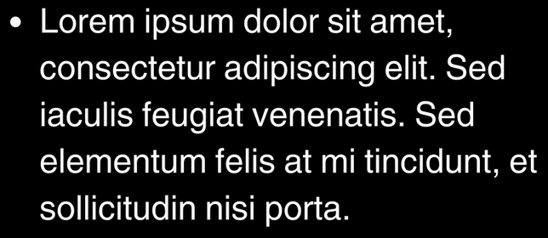

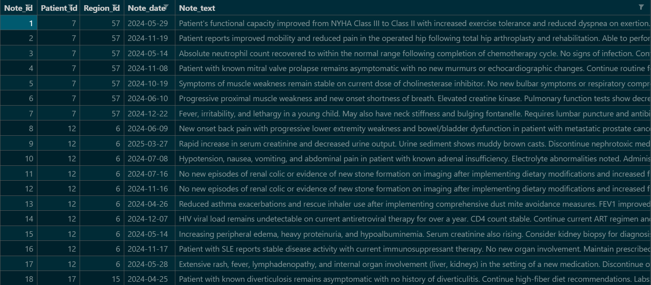


INPUT DATA STRUCTURE
CLINICAL NOTES DATASET GENERATION – METHODOLOGY
The Problem:
It has a text field called note_text which is a doctor’s note on a patient. The note needs to be realistic with medical terms. Overall sentiment of the note needs to match trial_outcome from trial_results table.
Column Name | Datatype
Patient_id | Integer
Age | Integer
Gender | String
Region_id | Integer
Enrollment_date | Date
One – to – Many
Column Name | Datatype
Patient_id | Integer
Visit_date | Date
Health_metric | Float
Adverse_Event | Boolean
Trial_outcome | String
One – to – Many
Current Solutin:
We have taken help of mulltimple LLMs to generate realistic note_text for each trial_outcome category while making sure the notes are not repeating.
Trial_results
Patients_data
One – to – Many
Column Name | Datatype
Note_id | Integer
Patient_id | Integer
Region_id | Integer
Note_date | Date
Note_text | Text
One – to - One
We have a large list of note_text for each trial_outcome, using a python script we have generated our clinician_notes file. The data distribution will be shown later.
Column Name | Datatype
Region_id | Integer
Region_name | String
Total_patients | Integer
Clinician_notes
Regions_data
Patients_data, Regions_data and Trial_results
were generated from ‘Mockaroo - Random Data Generator’. It allows for rule based data generation as well.

Slide 4

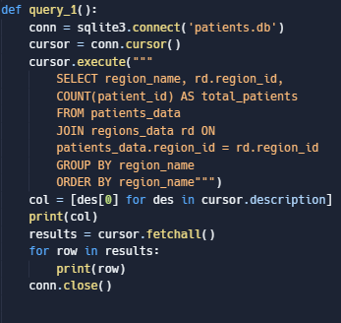
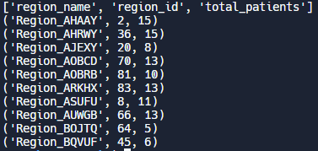
SQL BASED SOLUTIONS
Calculate the total number of patient enrolled in each region.
Output

Slide 5

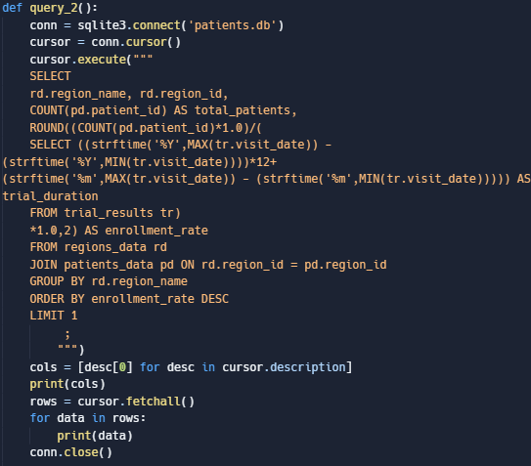
Identify the region with fastest enrollment rate by comparing total patient enrolled with the trial duration
Output

Slide 6

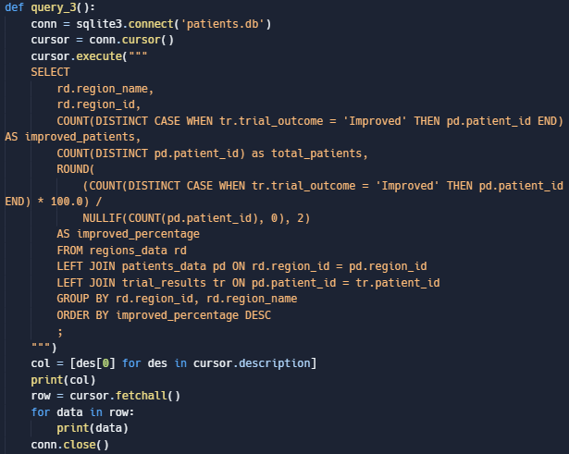
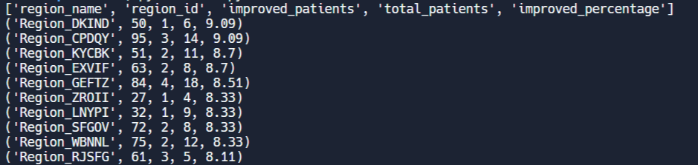
Determine the percentage of patients in each region who show "improved" outcome
Output

Slide 7
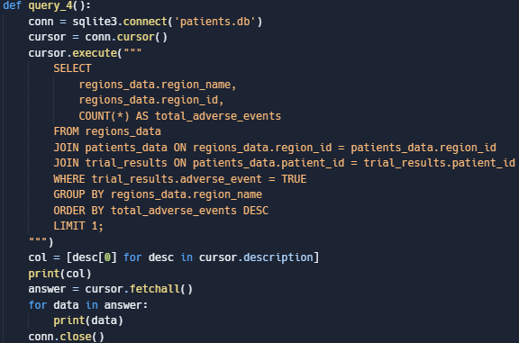
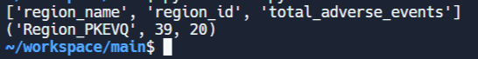
Find the region with most adverse events .
Output
www.reallygreatsit.com

Slide 8

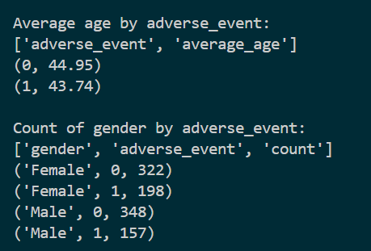
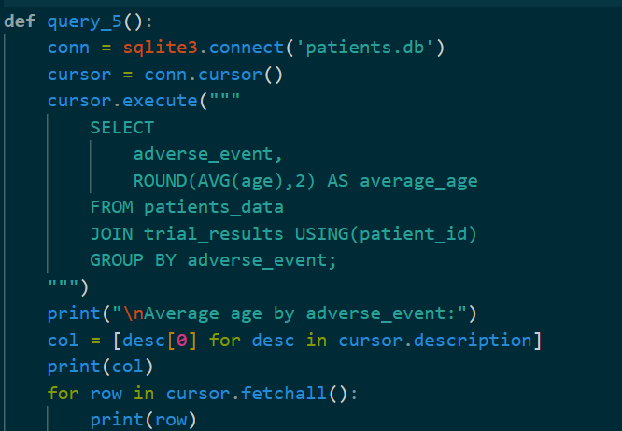
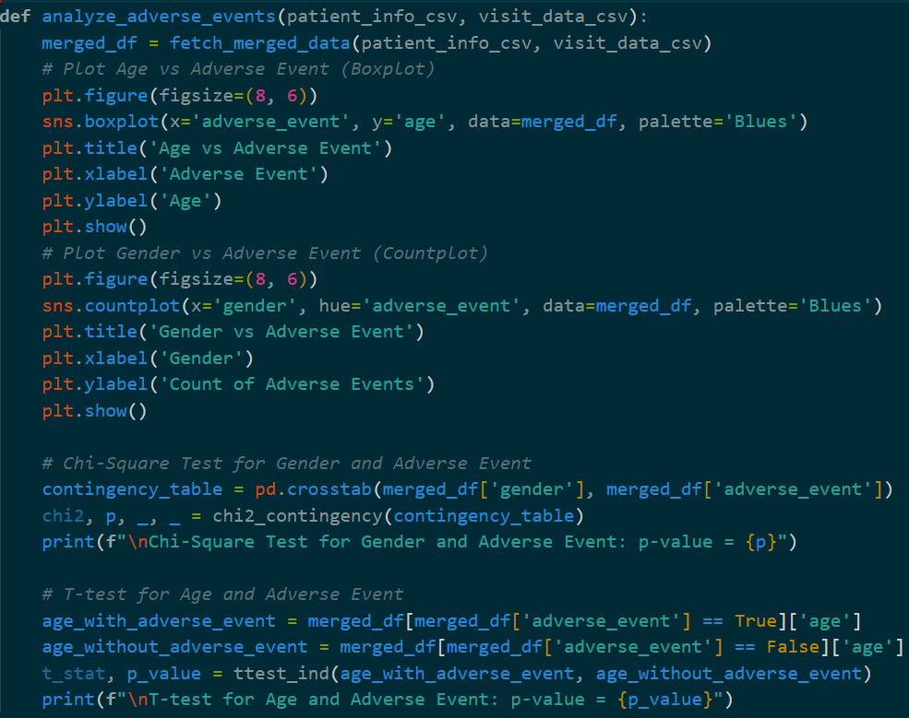
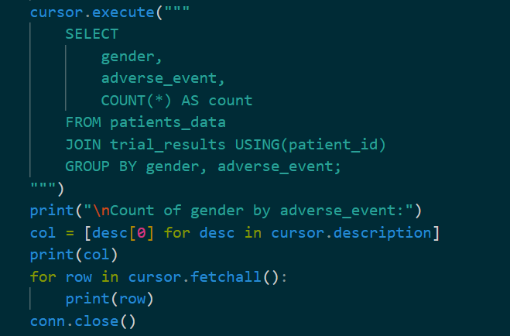
Analyze whether age or gender correlates strongly with adverse events .
Output

Slide 9
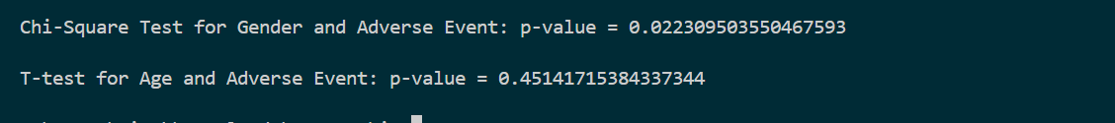
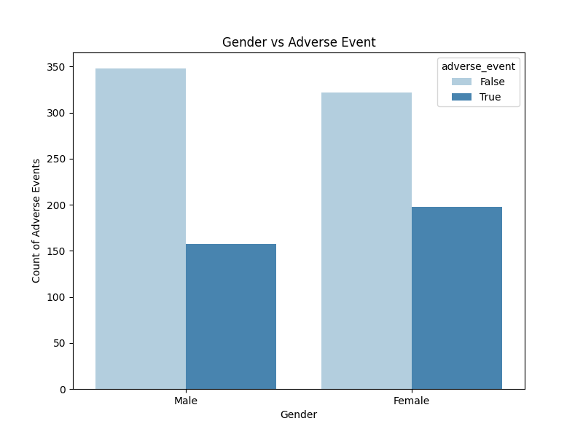
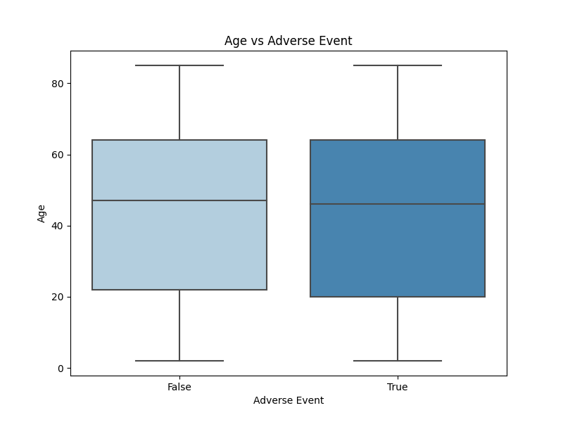
Analyze whether age or gender correlates strongly with adverse events .(cont.)
Output
Chi-Square Test for Gender and Adverse Event : p-value = 0.0223
Interpretation: Since this p-value is less than 0.05, we reject the null hypothesis.
Conclusion: There is a statistically significant association between gender and the likelihood of experiencing an adverse event.
T-test for Age and Adverse Event: p-value = 0.4514
Interpretation: Since this p-value is greater than 0.05, we fail to reject the null hypothesis.
Conclusion: There is no significant difference in the average age of those who experienced an adverse event vs those who did not.
We have arrived at such conclusions mostly due to randomness of our genrated dataset.

Slide 10
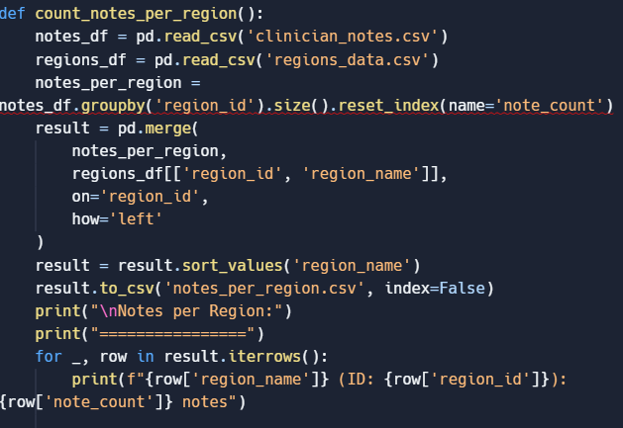
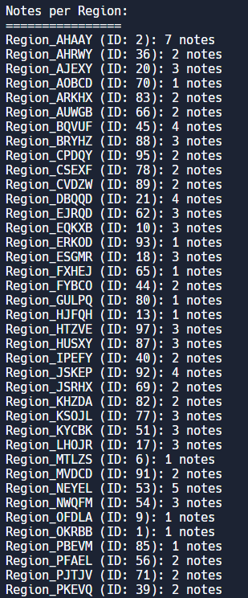
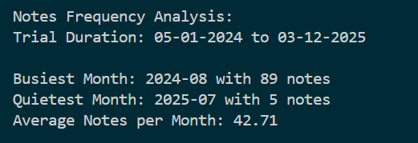
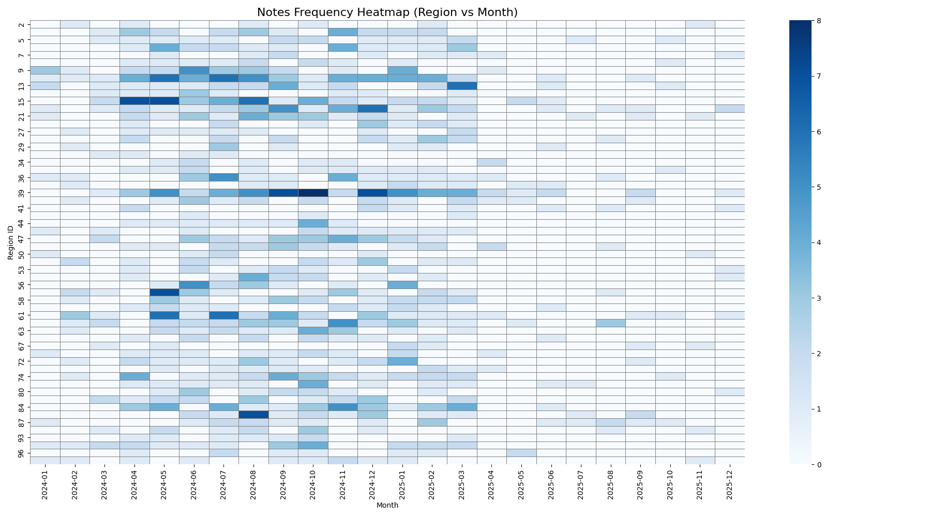
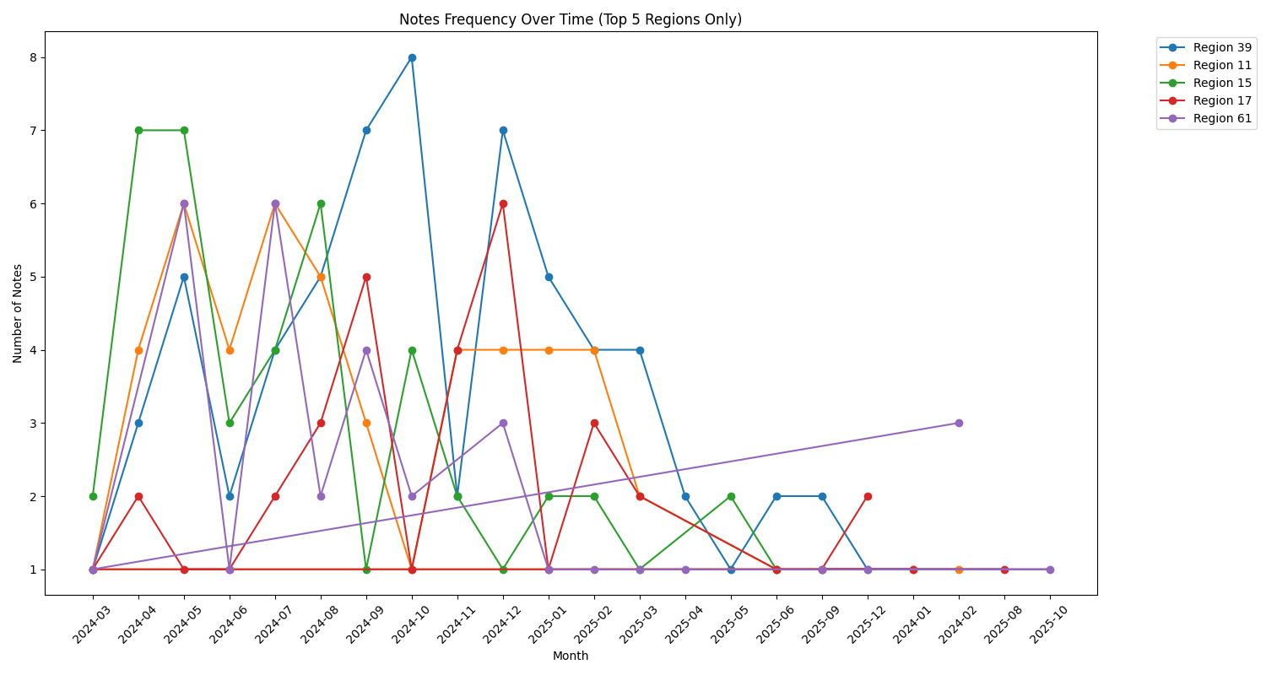
PYTHON BASED
Count the number of notes per region and analyse their frequency over the trial duration .
Output

Slide 11
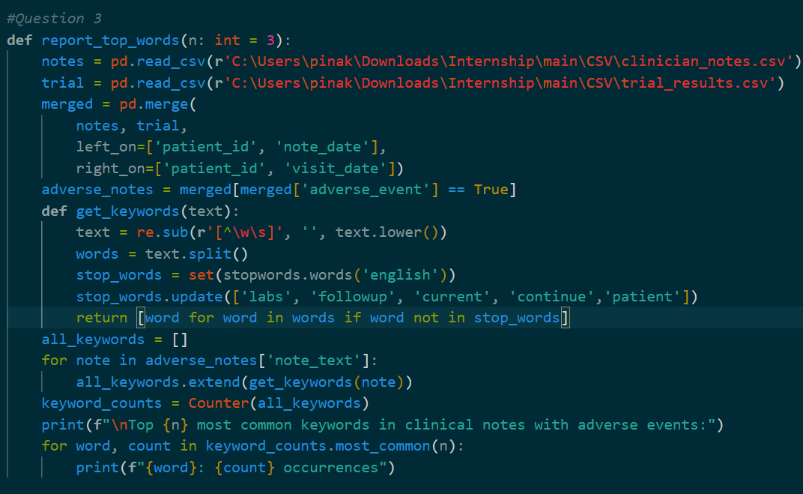
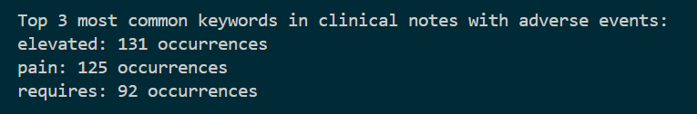
Generate a report showing 3 most common keywords in clinician notes from patient reporting adverse event .

Slide 12
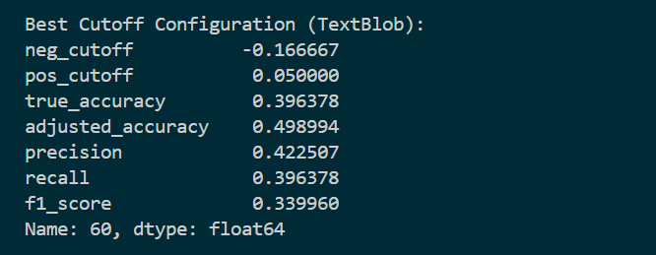
Apply Sentiment Analysis on the note_text field to classify the sentiment as ‘positive’ , ‘negative’ , ‘neutral’ .
Text Preprocessing :
TextBlob already handles basic preprocessing internally, such as tokenization, lowercasing, and punctuation handling. Extra preprocessing might remove important cues like negations or word order that affect sentiment.
Solution Approach 1 : Using TextBlob
Pros
Cons
Based on predefined lexicons, making the sentiment decisions transparent and easy to explain.
Medical notes are often nuanced, domain-specific, and full of negations (“no signs of infection”) — TextBlob fails to catch that depth.
Performs reasonably well on clean, general English content like product reviews or news articles.
Doesn’t adapt or learn from the dataset — stuck with a fixed polarity dictionary, which isn't tailored to clinical language.
Works out of the box without requiring labeled data or model training.

Slide 13
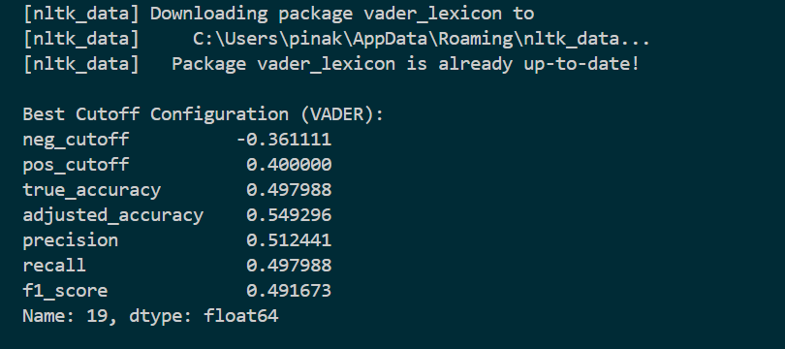
Solution Approach 2 : Using NLTK Vader
VADER is specifically tuned for social media and informal text, and it relies on things like punctuation, capitalization, emojis, and negations to detect sentiment accurately. So, minimal or no preprocessing is best for VADER too — it’s designed to work well as is on raw text.
Text Preprocessing :
Pros
Cons
VADER understands things like capital letters, exclamations, and intensifiers (e.g., "very", "extremely")
VADER may oversimplify complex or nuanced phrases common in clinician notes.
It provides a compound score that makes it easier to set custom sentiment thresholds
For a rule-based, no-training approach, 57% is decent—especially for niche text like clinician notes.

Slide 14
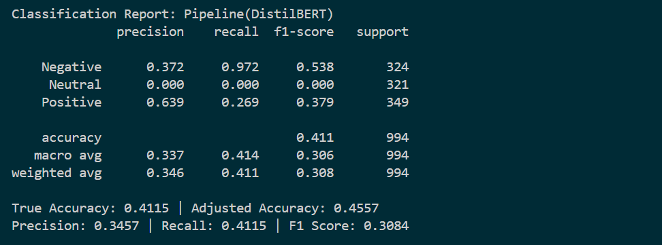
Solution Approach 3 : Using DistilBERT
No preprocessing is needed.
Underlying model is distilbert/distilbert-base-uncased-finetuned-sst-2-english
Provides a sentiment pipeline, given a text, the pipeline labels it as “Positive”, “Negetive”, or “Neutral”
Analysis
DistilBERT is giving low accuracy on clinical notes because it’s pretrained on general-domain or social media text (like Wikipedia and books) fine-tuned on Stanford Sentiment Treebank(sst2) , not domain-specific language. Clinical notes use technical, medical jargon and structured styles that DistilBERT hasn't seen, so it struggles to understand context and sentiment accurately in that domain.

Slide 15
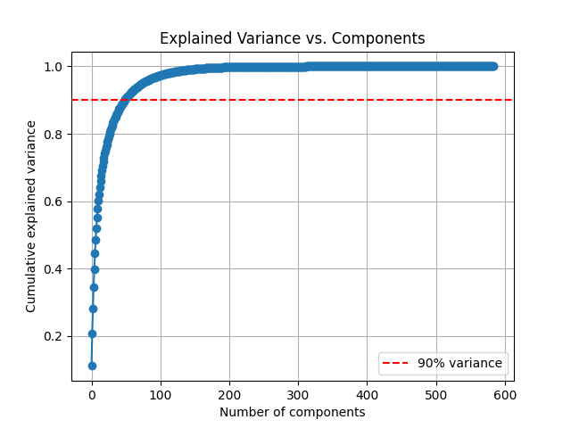
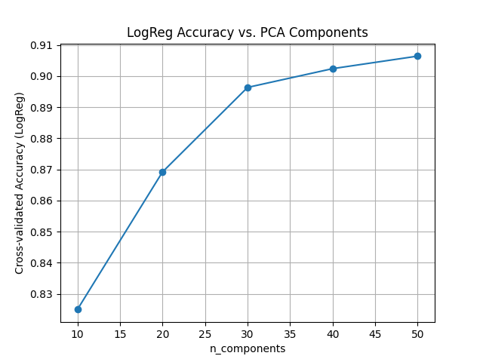
Solution Approach 4 : Using Machine Learning Approach
Using pre-trained ClinicalBERT model from Hugging Face's medicalai/ClinicalBERT, trained on clinical notes.
This includes:
The tokenizer to prepare text input
The model to generate contextualized embeddings
Encodes the expected labels using LabelEncoder, loads the ClinicalBERT model, and generates embeddings for the clinical notes.
BERT embeddings are 768-dimensional. Use PCA (Principal Component Analysis) to reduce dimensionality:
Plot the cumulative explained variance to see how many components we need to retain ~90% of information.
It then tests the performance of Logistic Regression using different PCA components (10 to 50), evaluates accuracy with cross-validation, and selects the best number of components. Finally, it applies PCA with the optimal number of components to transform the embeddings.
In our dataset 50 components explain 90% variance.

Slide 16
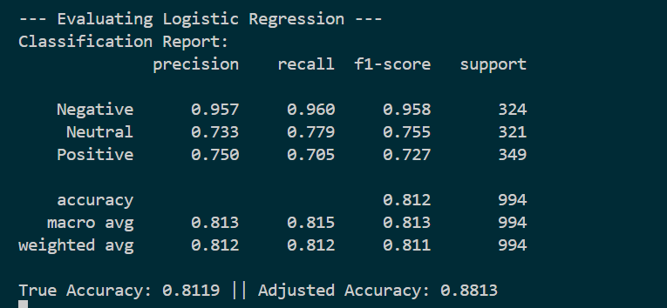
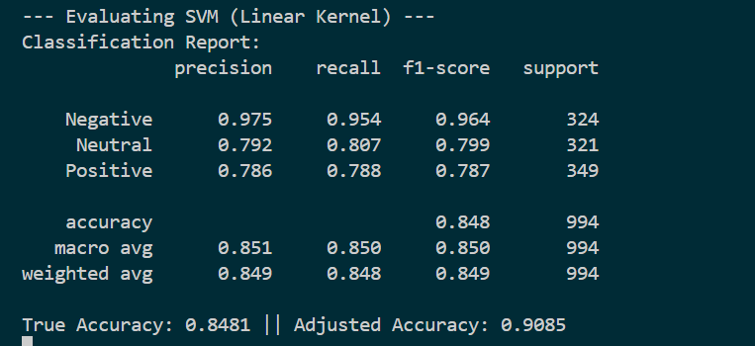
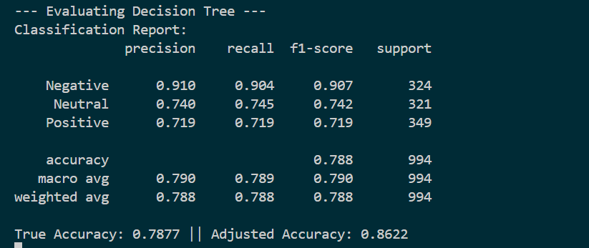
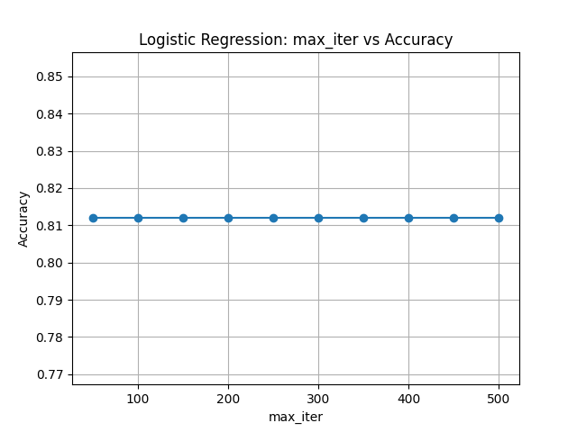
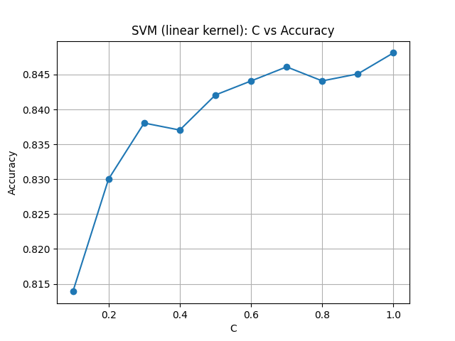
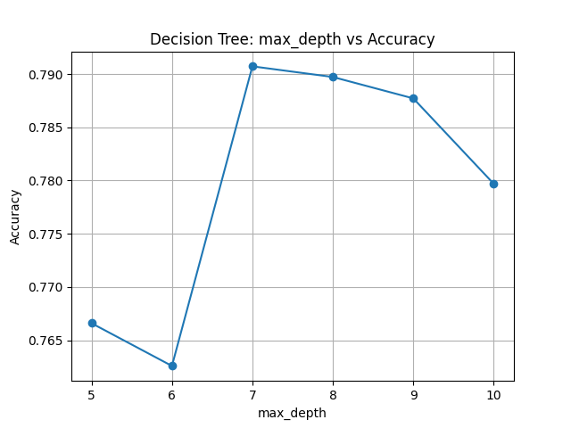
Solution Approach 4 : Using Machine Learning Approach
Logistic regression
SVM
Decesion Tree

Slide 17
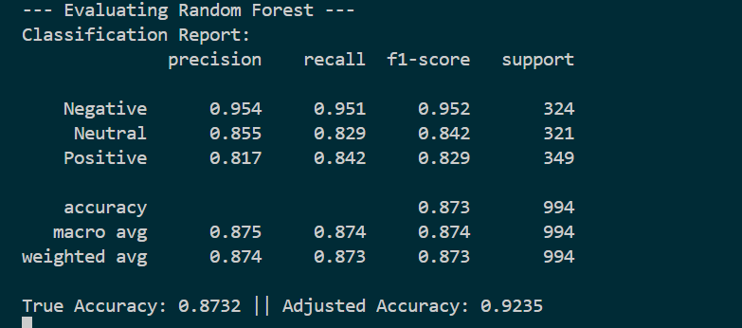
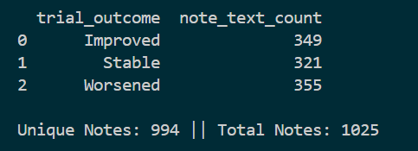
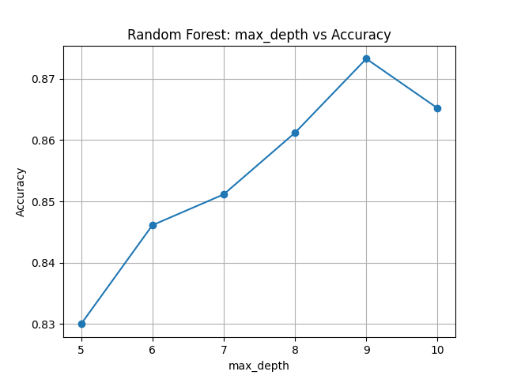
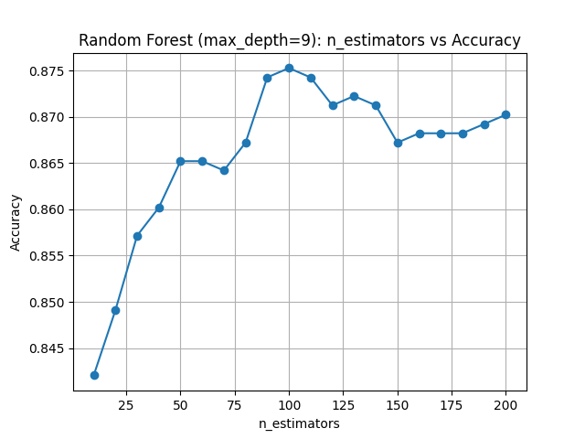
Solution Approach 4 : Using Machine Learning Approach
Random Forest
Overall best model from the ones tested is “Random Forest” with max depth of 9 and 100 estimators. These values are based on our test results.

Slide 18
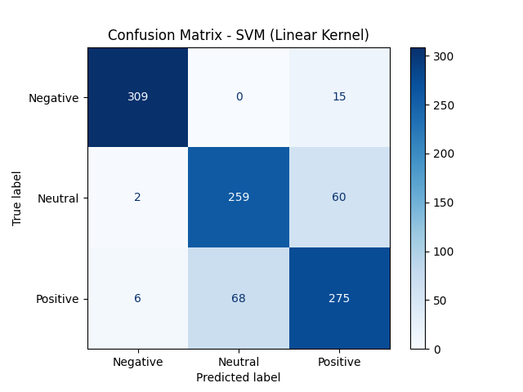
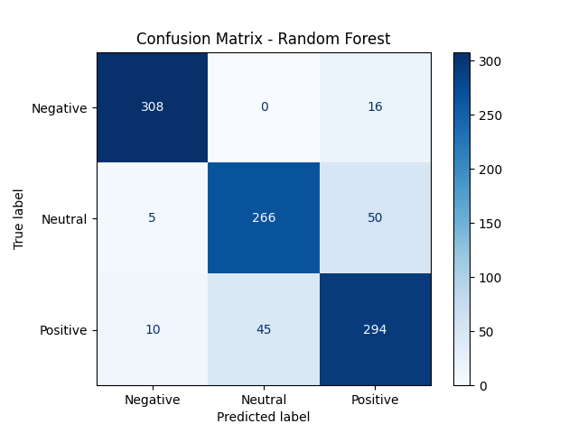
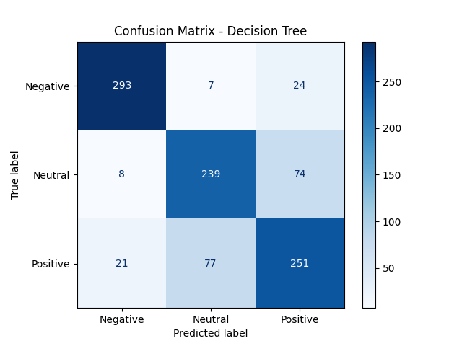

Analysis
Model | Positive Precision | Negative Precision | Neutral Precision | Observation
SVM ( Linear ) | High | High | High | Most accurate overall
Decesion Tree | Moderate | Moderate | Moderate | Overfitting risk
Logistic Regression | Very High | Lower | Moderate | Best at detecting negative tone
Random Forest | High | Best | High | Best balanced performance overall

Slide 19
Summarize key concern and trends whose sentiment is classified as ‘negative’ .
METHODOLOGY FOR FINDING NEGETIVE TRENDS
Sentiment Analysis
Classify each note_text into sentiment categories .
Extract Negative Sentiment Data
Filter the dataset for rows with negative sentiment
Vectorization
Convert the text data into a numerical matrix using TfidfVectorizer.
Apply the KMeans algorithm to group the negative notes into clusters based on similarity. This helps identify which phrases (1- or 2-gram) are more important per note.
For each cluster center, get the top 5 TF-IDF terms that define it.
These terms represent the core idea or theme of that cluster.
Apply KMeans Clustering
Summarize Trends
Present a summary of each trend by displaying the top terms and notes containing those terms.

Slide 20
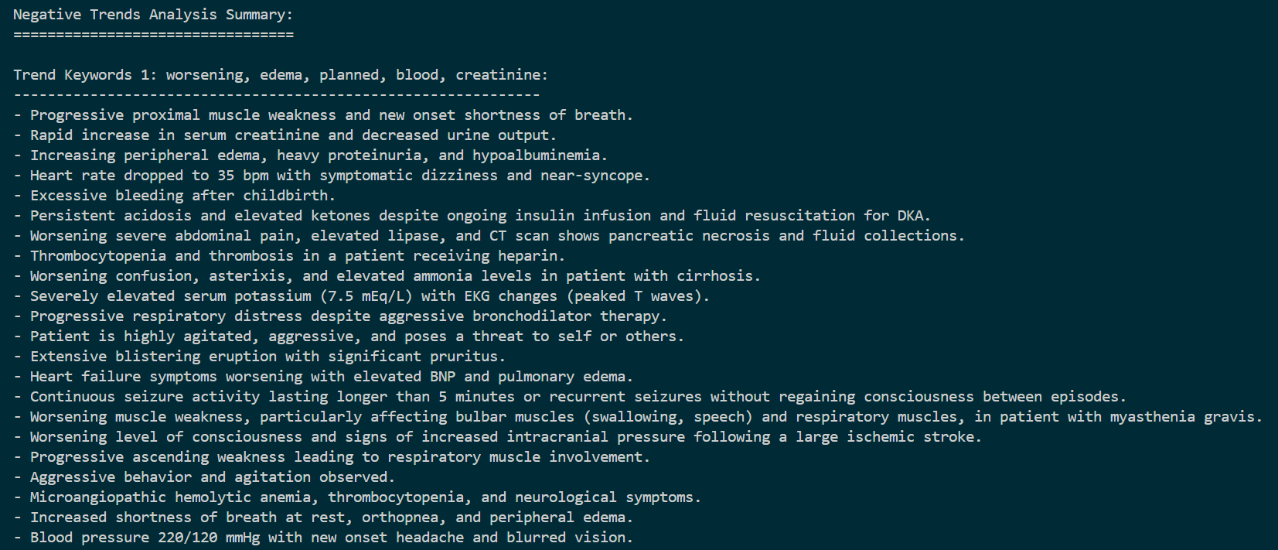
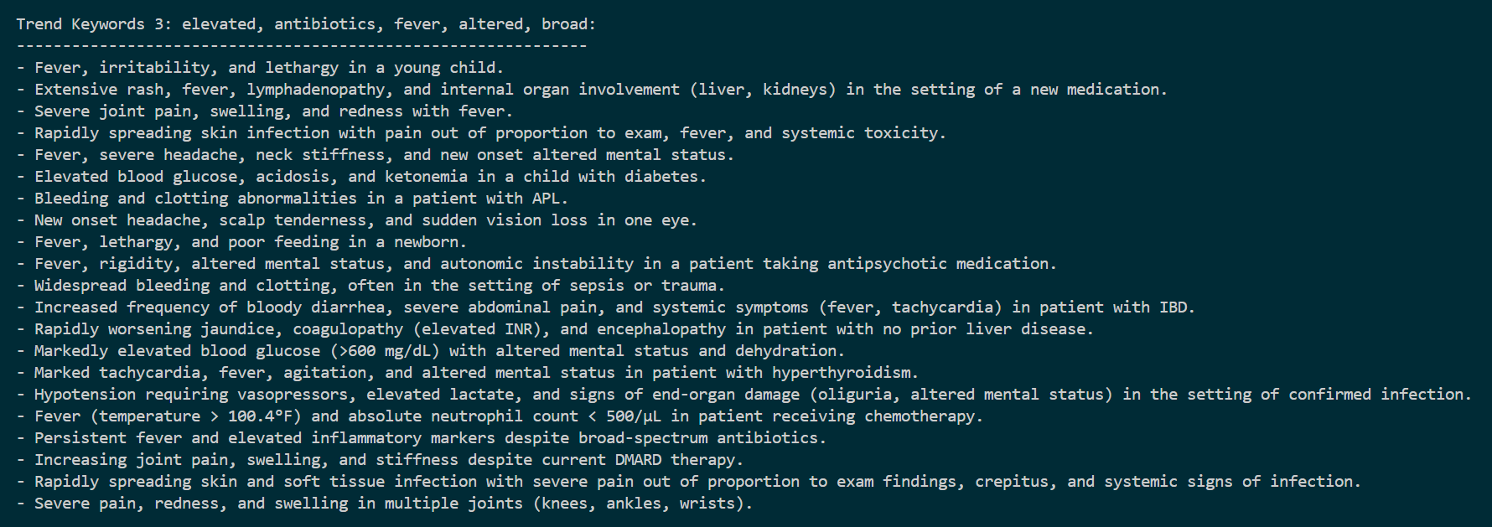
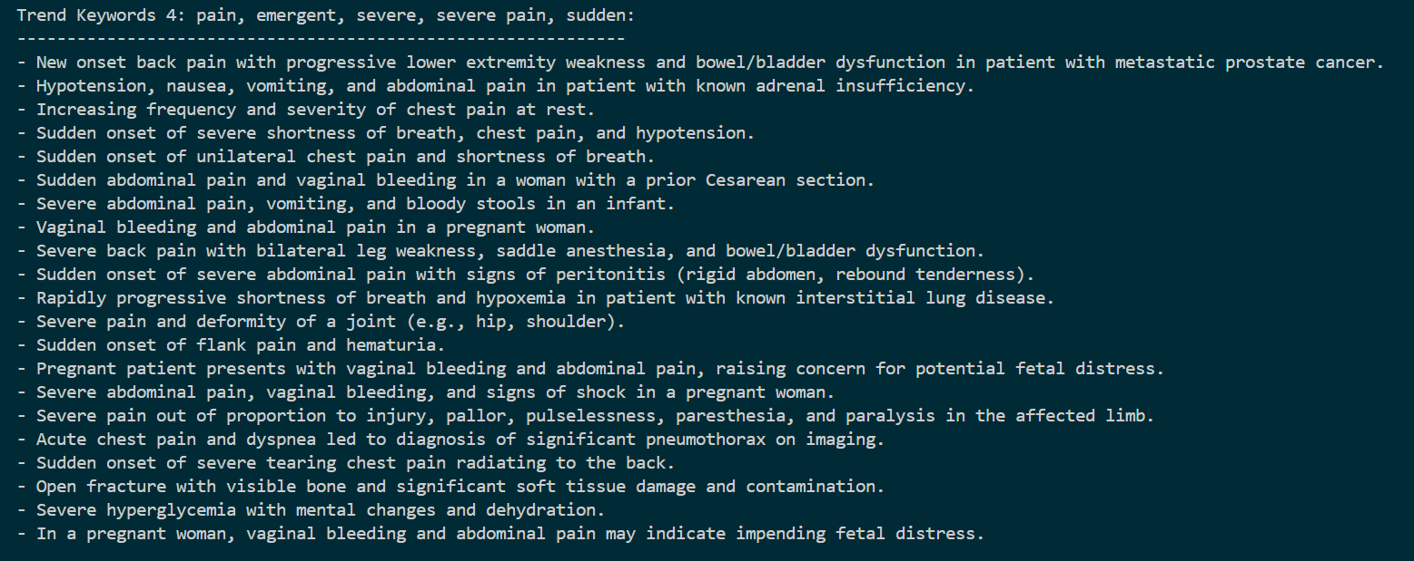
Summarize key concern and trends whose sentiment is classified as ‘negative’ .
OUTPUTS
TREND KEYWORDS 1
TREND KEYWORDS 2
TREND KEYWORDS 3
TREND KEYWORDS 4

Slide 21
Compare the frequency of adverse event in SQL Data with mention adverse effect in clinician notes to capture the discrepancies .
METHODOLOGY FOR FINDING ADVERSE EFFECTS
Collect Adverse Notes
Collect all unique note texts showing negetive trends from previous analysis into a list called adverse_notes.
These notes are considered known examples of adverse effects due to their content and clustering.
Vectorization
Vectorize the notes using Tfidf as follows
tfidf_adverse → Vectors of the adverse notes
tfidf_main → Vectors of all original notes
Use: cosine_similarity(tfidf_main, tfidf_adverse)
Compares every note to each known adverse note.
For each original note, find the maximum similarity to any adverse note.
Find Similarity
Flag Notes
Flag Similar Notes as Adverse
Threshold: Any note with similarity score ≥ 0.75 is flagged.
Such a threshold was chosen based on number of total adverse_events in our dataset.

Slide 22
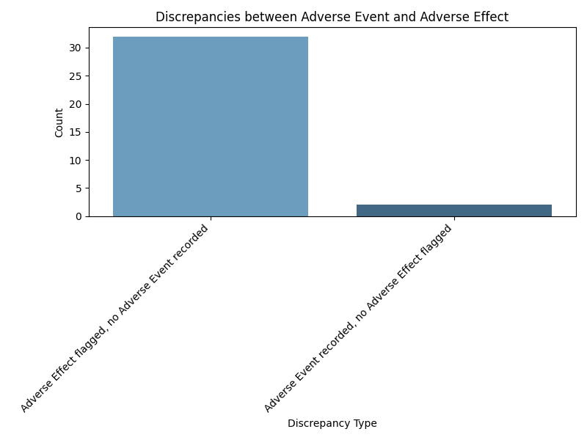
Compare the frequency of adverse event in SQL Data with mention adverse effect in clinician notes to capture the discrepancies .
Methodology
Using our previous methodology we label notes for adverse_effects as True or False. We have the adverse_event label for that note in trial_results table.
We can identify and isolate two types of discrepancies:
Type 1: adverse_event is True but adverse_effect is False.
Type 2: adverse_effect is True but adverse_event is False.
Example discrepancies
Urine albumin-to-creatinine ratio decreased following increase in ACE inhibitor dosage. Continue current regimen and monitor proteinuria regularly. Labs: ACR=Decreased, Serum albumin=Stable. Arrangements for follow-up will be made.
Adverse Effect flagged, no Adverse Event recorded
Continuous seizure activity lasting longer than 5 minutes or recurrent seizures without regaining consciousness between episodes. Administer benzodiazepines and other anti-epileptic medications urgently. Labs: EEG=Continuous seizure activity, Electrolytes=May be abnormal.
Adverse Event recorded, no Adverse Effect flagged

Slide 23
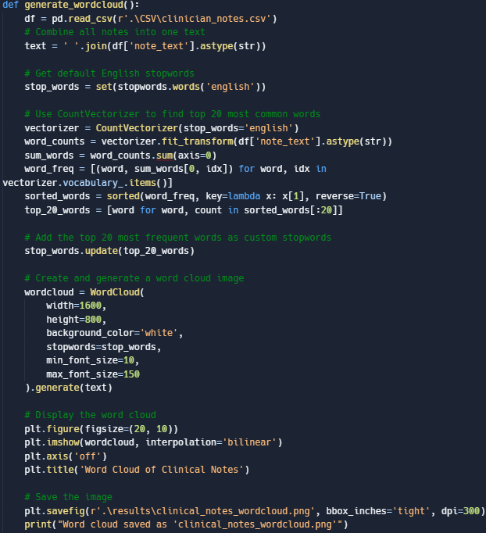
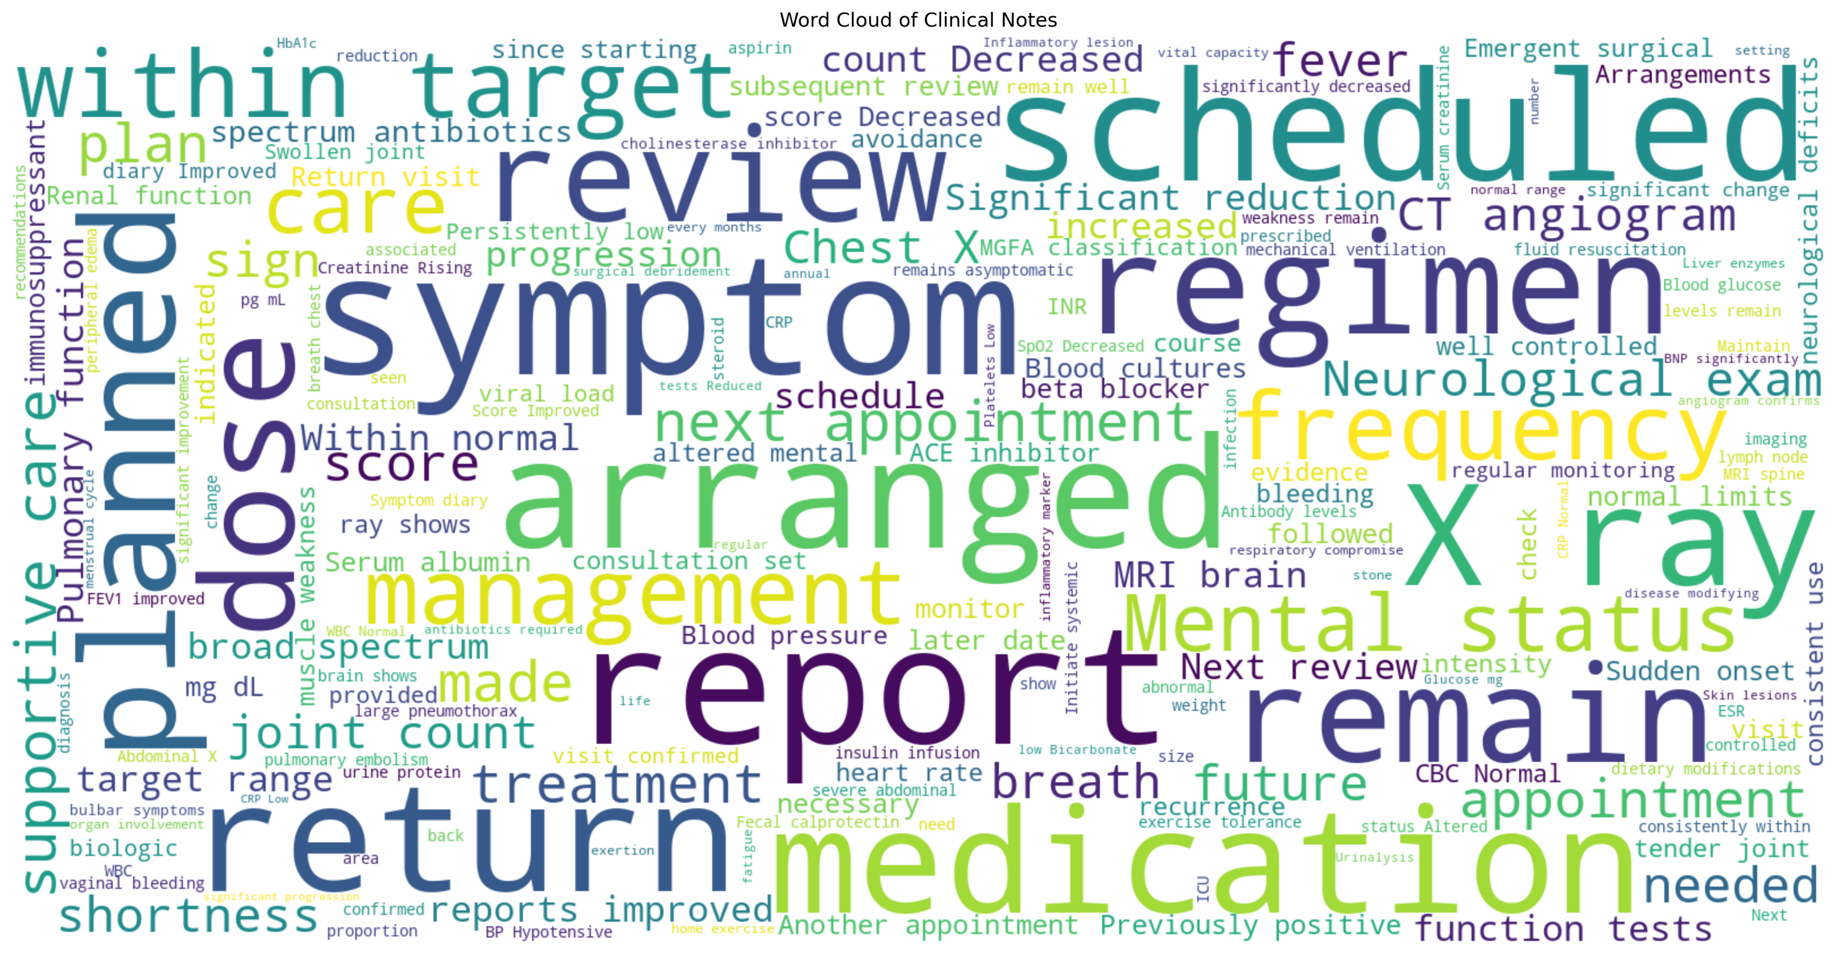
Use word clouds to capture recuring pattern in clinician notes .

Slide 24
Testing and validation
Stratified K-Fold Cross-Validation (5-Folds)
What it does:
Splits your data into 5 stratified folds.
Ensures each fold has approximately the same distribution of sentiment classes (e.g., Positive, Negative, Neutral).
Process:
For each of the 5 iterations:
Train on 4 folds. Test on the remaining 1 fold
This cycle repeats until every fold has served as the test set exactly once.
This produces a robust estimate of model performance, less sensitive to how the data is split.
Evaluation Metrics
Check for: Precision, Recall, F1-score for each class
Gives a detailed look into how well the model performs across different sentiments.
True Accuracy:
Percentage of correct predictions when “Improved”=Positive, “Stable”= Neutral and “Worsened”= Negative .
Adjusted Accuracy:
If the true label is Stable, predicting 'Positive' sentiment is still acceptable.
For all other cases, the prediction must exactly match the true label.
This helps accommodate ambiguity around neutral sentiments, which are often borderline.
Preventing Data Leakage
We are evaluating a model using Stratified K-Fold Cross-Validation, and inside each fold:
Split the dataset into training and testing sets
Apply PCA only on training data
Transform the test data using that fitted PCA
Train the model on the transformed training data
Predict on the transformed test data
Collect all true/predicted labels for evaluation
Areas for further research
While our current analysis focuses on model performance and textual interpretation, future work could include a more in-depth feature importance visualization to better understand the decision-making process behind sentiment predictions.

Slide 25
THANK YOU

